Slide 1

Overview
MD19 is launching a coordinated membership growth campaign supported by a $10,000 Lions Clubs International marketing grant. The initiative uses digital marketing and social media to grow awareness, attract new members, and form new clubs across Washington, B.C., & Northern Idaho.
Goals
10 new clubs
100 new members
Stronger visibility of Lions service through consistent messaging
Primary Strategy
Paid and organic social media (Facebook)
Centralized graphics, captions, instructions
Clear call to action for all clubs
Notes:
I want to start by zooming out for just a minute and talking about what this campaign really is.
The Grow With Us marketing campaign is a Multiple District–wide initiative across MD19, designed to help all of our clubs grow in a way that feels doable, consistent, and sustainable.
At its core, this is about telling our story better — and telling it together.
Initiative Overview
This initiative was built to support clubs by giving you ready-made marketing tools that spotlight what Lions already do best: service, impact, and community connection.
You don’t have to be a marketer. You don’t need to reinvent the wheel. MD19 has created the framework — clubs just bring it to life locally.
Goals
Our goals are simple and shared:
Increase visibility of Lions in our communities
Attract new members who align with our mission
Support club growth and long-term sustainability
And just as important — we want to make marketing feel less overwhelming and more achievable for every club.
Primary Strategy
Our primary strategy is digital marketing, with a strong focus on Facebook — because that’s where our communities already are.
We’re using:
Monthly themed campaigns
Consistent visuals and messaging
Clear invitations to learn more or get involved
When clubs across MD19 post together using shared messaging, it creates recognition, momentum, and credibility.
This isn’t about perfection. It’s about showing up consistently and making it easy for people to say, ‘Yes — I want to be part of that.’

Slide 2
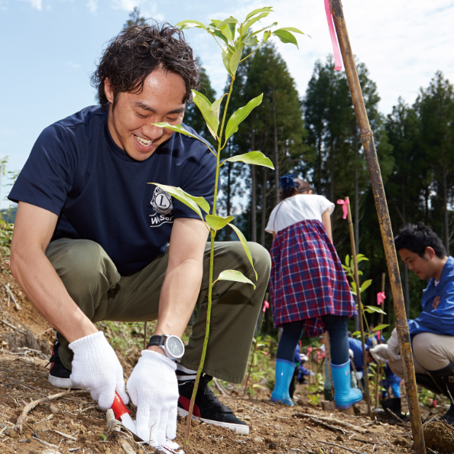
Topic 1
Shifting from Internal to External Messaging
What’s the Shift?
Internal Marketing: Posts for current members
External Marketing: Posts for the community
Notes:
Understanding the Shift
Most Lions Clubs naturally post content for current members. These posts are familiar, comfortable, and important—but they often assume the reader already knows who Lions are and what the activity means.
External marketing adjusts the wording so anyone in the community can understand the post and feel invited in.

Slide 3
External Caption: Curious about volunteering in Camas? Join the Camas Lions Club for our meeting tonight at 6:30 to learn how we serve our community and have fun doing it.
EXAMPLES
Internal Caption: Great job today, Lions! Thanks to everyone who came out this morning.
External Caption: This weekend, the Camas Lions Club rolled up our sleeves and planted trees to help reforest an area in need of restoration. These new trees will support local wildlife, improve air quality, and contribute to a healthier environment for future generations. Every tree is a reminder that small acts of service grow into lasting impact. Thank you to our volunteers and community partners who helped make it happen!
Internal Caption: Don’t forget—meeting tonight at 6:30!
External Caption: Curious about volunteering in Camas? Join the Camas Lions Club for our meeting tonight at 6:30 to learn how we serve our community and have fun doing it.
Internal Caption: Another successful food drive! Thanks, everyone!
External Caption: Thank you, Camas! The Camas Lions Club was proud to take part in the annual Walk & Knock food drive, collecting non-perishable food items to support local families in need. Your generosity helped stock local food banks and made a real difference for those facing food insecurity this winter. Together, we’re building a stronger, more caring community!
Notes:
Here are examples of how the same photo caption can be written two different ways.
Example 1: Service Project Photo
Internal Caption: Great job today, Lions! Thanks to everyone who came out this morning.
External Caption: Today, Camas Lions volunteered to pack food boxes for local families in need. Serving our community is what Lions do—and we’re always happy to welcome new volunteers.
Example 2: Event Announcement
Internal Caption: Don’t forget—meeting tonight at 6:30!
External Caption: Curious about volunteering in Camas? Join the Camas Lions Club for our meeting tonight at 6:30 to learn how we serve our community and have fun doing it.
Example 3: Fundraiser or Activity
Internal Caption: Another successful Walk & Knock! Thanks, everyone!
External Caption: Thank you, Camas! Because of your generosity, the Camas Lions Club helped collect food for local families through the annual Walk & Knock food drive.
Key Takeaway
Internal captions speak to members. External captions speak about service and invite the community.
A simple way to shift a caption is to add:
What the service was
Who it helped
Why it mattered
When posts are written this way, Lions service becomes visible, meaningful, and inviting to the public.

Slide 4
Topic 1
Shifting from Internal to External Marketing
Why It Matters
Builds awareness beyond our club
Attracts new members
Increases visibility of Lions service
How Clubs Can Transition
Gradually adjust post messaging
Keep members engaged while speaking to non-members
Share service in a way the public understands
Goal
Make Lions visible, welcoming, inviting, and relevant to the community
4
Notes:
Why This Matters
People cannot join an organization they do not see or understand. If Lions service is only visible to current members, the broader community never has the opportunity to learn who Lions are or how they can get involved.
External marketing helps:
Increase visibility so the community knows Lions are active
Build credibility by consistently showing real service
Improve relevance by connecting service to community needs
This is how Lions service turns into community interest—and how interest eventually turns into new members.
A Reassuring Note for Clubs
This is not an all-or-nothing shift.
Clubs are not being asked to stop internal posts or change everything at once. Internal marketing still matters and should continue.
What is changing is the lens. Posts should be written so they make sense not only to Lions, but also to someone in the community who may be seeing your club for the very first time.
A Simple Transition Plan
Start small. One change at a time makes a big difference.
Rewrite captions so they explain the service, not just show a photo
Add one sentence that speaks directly to the community
Continue recognizing members while also explaining why the work matters
This approach keeps current members engaged while intentionally inviting non-members to learn more.
Key Takeaway
The goal is simple:
Make Lions visible, welcoming, and understandable to the community.
When people can clearly see what Lions do—and why it matters—they are far more likely to show interest, attend an event, volunteer, and eventually become members.

Slide 5

aa
Topic 2
Facebook Content Activity & Consistency
The Goal
Be visible, predictable, and active
5
Notes:
Topic 2: Facebook Content Activity & Consistency
Before we talk about tools, tips, or algorithms, it’s important to set the right tone.
Facebook success is not about perfection—it’s about consistency.
Many clubs hesitate to post because they think they need the perfect photo, the perfect wording, or the perfect graphic. The truth is, none of that matters as much as simply showing up—again and again.
Facebook rewards activity. People trust what they see consistently. And communities connect with organizations that feel active, visible, and engaged.
This topic is about building habits, not pressure. It’s about creating a rhythm of posting that feels manageable, repeatable, and sustainable for clubs of all sizes.
That’s why we’re encouraging a 90-day pilot period—a short, realistic commitment where clubs focus on posting regularly, learning what works, and gaining confidence along the way.
Consistency is what turns:
Events into awareness
Awareness into engagement
Engagement into community trust
And once that trust is built, growth follows.

Slide 6

Topic 3
2-Pronged Content Strategy
A. Service Project Storytelling
☑ At least 1 service project per month ☑ If no project → post about what Lions do ☑ Need more service? ☐ Partner with another Lions Club ☐ Share a joint service project
B. Member Recruitment Graphics
☐ MD19 Grow With Us ready-to-post digital marketing assets for social media
☐ Monthly and themed
☐ Graphics and captions
Goal
Show service → Invite participation → Grow membership
6
Notes:
Top Priority: Service Projects
Service projects should be the #1 content focus on a club’s Facebook page.
Aim for at least one service project per month
Service posts show impact, purpose, and relevance
Service content builds trust and community awareness
If Your Club Has No Recent Service to Share
Create a generic service-focused post explaining what Lions do
Highlight the causes your club supports
Share how Lions help locally and globally
If More Service Opportunities Are Needed
Partner with another Lions Club
Plan a joint service project
Both clubs benefit from shared service and shared content
Partnerships increase impact and make content creation easier.
Creating a Healthy Content Mix
A strong Facebook page includes a balance of:
Service project storytelling (primary focus)
Member recruitment messaging (secondary focus)
Use the recruitment graphics provided by the MD19 Marketing Team to support membership growth. These should be sprinkled in naturally alongside service content—not replace it.
Service shows what Lions do. Recruiting invites people to join in.
Key Takeaway
Photos tell the Lions story faster than words.
By consistently sharing strong service photos, simple captions, and a balanced mix of content, clubs make Lions:
Visible
Approachable
Relevant to their community
When people see Lions in action, interest grows—and growth follows.

Slide 7
Before
Leading Up
After
aa
Topic 3
Service Project Storytelling
90-Day Consistency Challenge
☐ Commit to posting regularly ☐ Try this for 90 days
Before the Event
☐ Create a Facebook Event ☐ Post about the activity ☐ Invite community members
Leading Up
☐ Post 1–2 reminders
After the Event
☐ Post within 24 hours ☐ Share photos + a short recap
Consistency builds visibility, reach, and confidence
7
Notes:
90-Day Consistency Pilot: A Simple Approach That Works
To help clubs build strong and sustainable Facebook habits, we encourage a 90-day consistency pilot. This is not about perfection or posting every day—it’s about creating a realistic rhythm and sticking with it long enough to see results.
Over 90 days, clubs begin to:
Build confidence in posting
Develop repeatable habits
Create enough visible content for community members to recognize activity
Learn what works for their club and their audience
A short-term commitment makes the process manageable and less intimidating.
Posting Checklist: Before, During, and After Activities
The most effective Facebook pages follow a simple pattern: before the activity, leading up to it, and immediately after.
Before the Activity
Every activity should be posted before it happens. This creates awareness and gives the community a chance to engage.
Use Facebook Events whenever possible Facebook Events extend your reach beyond your page and make activities easier to find and share.
Create the Facebook Event three weeks in advance when possible
Build a posting schedule based on the event date
Leading Up to the Event
As the event approaches:
Post reminders
Share short updates or photos
Build excitement and curiosity
Invite community members, not just Lions
These reminders help keep the event visible and reinforce that Lions are active and welcoming.
After the Event
Post the same day or within 24 hours while the experience is still fresh.
Share photos
Briefly explain what happened and why it mattered
Thank participants or the community
Timely posts feel authentic and complete the story.
Why This Works
This approach works because it aligns with how Facebook and people behave.
Facebook favors active pages
Repetition builds recognition
Consistency builds confidence—for both the club and the audience
When people repeatedly see Lions serving the community, trust and familiarity grow naturally.
A Word of Encouragement
You do not need fancy graphics, perfect photos, or carefully polished wording.
You simply need to show up consistently.
Real photos, simple captions, and steady posting matter far more than perfection.
Key Takeaway
Consistency is what builds visibility, reach, and momentum.
When clubs commit to steady posting over time, community awareness grows—and growth becomes possible.

Slide 8
Topic 3
Service Project Photos & Content
Photos That Perform Best
☐ People in action ☐ Faces + service moments ☐ Community settings ☐ Clear Lions presence (shirts, vests, banners)
Captions Made Easy
☐ Use AI to write short, engaging captions ☐ Answer: Who • What • Where • Why it matters ☐ Keep it simple and friendly
How Many Photos?
☐ 3–5 strong photos per post ☐ Quality over quantity
8
Notes:
Topic 3: Photos & Content Strategy
Photos are the most important part of a Facebook post. Strong photos stop people from scrolling, tell a story quickly, and help the community understand what Lions do—often before they read a single word.
This section provides guidance on choosing effective photos, writing simple captions, and building a balanced content mix that supports service visibility and membership growth.
What Types of Photos Perform Best
The best-performing photos show people and action. These images feel authentic and help the community picture Lions actively serving.
Strong photo examples include:
Lions in action (serving, sorting, building, assisting)
Faces and natural interactions
Community members engaging with Lions
Clear Lions visibility (shirts, vests, banners, signage)
Group photos taken after an event are fine, but action photos taken during the service tell a much stronger story.
Quick tip: If you can only take one photo, take it while the service is happening, not after it’s over.
Using AI to Write Captions Quickly
Writing captions does not need to be time-consuming. AI tools can help clubs create short, engaging captions that match their photos.
A simple caption formula works well:
Who did the service
What was done
Where it happened
Why it mattered
Example prompt for AI tools:
Write a friendly Facebook caption explaining this Lions service project and why it helps the community.
Captions should be:
Clear and conversational
Written so non-Lions can understand
Focused on service impact, not internal details
How Many Photos to Post
More photos are not always better.
Recommended guidelines:
3–5 strong photos per post
Choose quality over quantity
Avoid uploading long photo albums unless they add value
A few clear, meaningful photos are more effective than many similar ones.

Slide 9
Topic 3
Service Project Photos & Content
GOOD
Group posed after the event
Everyone standing in a line
Smiling, but static
Little context about the service
Why it’s OK: ✔ Shows participation ✔ Easy to take
BETTER
Lions in action (serving, sorting, building, helping)
Close-ups of faces + hands
Interaction with community members
Lions shirts, vests, or banners visible
Why it works: ✔ Tells a service story ✔ Feels authentic and human ✔ Stops the scroll
9
Notes:
GOOD Photos
A Good photo is one that documents participation. These photos are easy to take and commonly shared, and they still have value.
Good photos typically include:
Group photos taken after an event
Lions standing or sitting in a line
Everyone smiling at the camera
Little visible action or motion
Why these photos are good:
They show that an activity happened
They recognize member involvement
They are quick and comfortable to take
Limitations of good photos:
They often require insider knowledge to understand
They don’t clearly show what service was performed
They are less engaging for people outside the club
Good photos work best for internal communication and record-keeping, but on their own, they may not fully capture the impact of Lions service for the community.
BETTER Photos
A Better photo tells a story. These images help people immediately understand what Lions are doing and why it matters.
Better photos typically include:
Lions in action during the service
Close-ups of hands, faces, or interaction
Movement and natural moments
Community members engaging with Lions
Visible Lions branding when possible
Why these photos work better:
They clearly show the service being performed
They feel authentic and human
They stop people from scrolling
They help non-Lions understand Lions’ impact instantly
Better photos allow the viewer to imagine themselves participating, which is a powerful step toward engagement and interest.
Quick Comparison
Good photos show who was there
Better photos show what was done and why it mattered
Simple Tip for Clubs
You don’t need professional photography skills.
While taking a group photo at the end of an event, also take:
One action photo
One close-up
One interaction shot
Those few extra seconds can turn a good post into a better one.
Key Takeaway
Good photos document service. Better photos tell the story of service.
And stories are what connect Lions to their community.

Slide 10
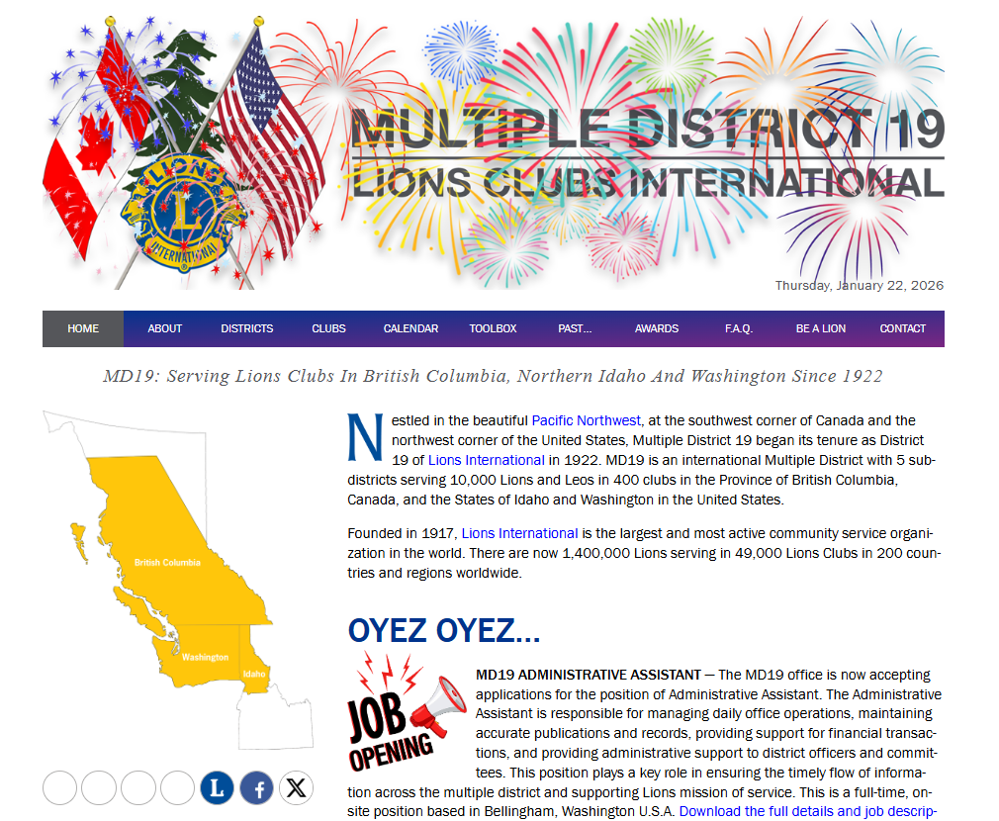
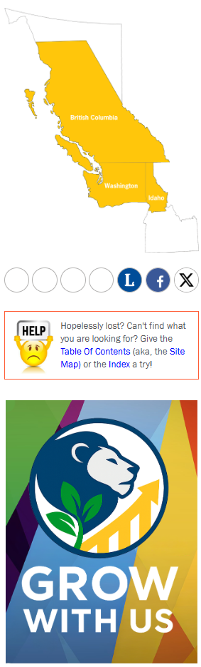
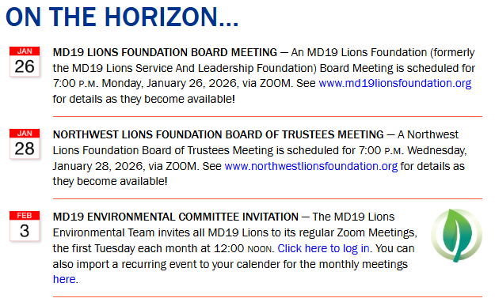
Topic 4
Grow With Us
Campaign assets live at: lionsmd19.org/marketing.php
Includes graphics, captions, instructions, and weekly themes
Clubs use provided materials—no redesign needed
Notes:
this is where the heavy lifting has already been done for you. MD19 has created a central hub for our Grow With Us marketing campaign, and everything you need lives in one place.
What’s included there:
Ready-to-use graphics
Suggested captions
Simple instructions
Weekly themes so you’re never guessing what to post
The big takeaway here is this: you do not need to redesign anything. Just use what’s provided. Consistency across MD19 is what makes this work.
Here’s how to get there — it’s super easy:
Step 1: Go to https://lionsmd19.org
Step 2: Click on the large Grow With Us graphic right on the homepage. That will take you straight to lionsmd19.org/marketing.php

Slide 11
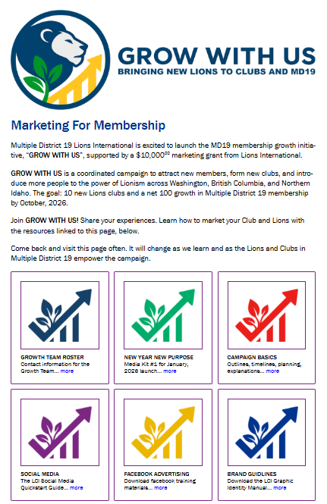

Topic 4
Notes:
Once you land on this page, this really becomes your single source of truth for the entire Grow With Us campaign.
Seriously — bookmark it.
And please share it with whoever runs your club’s Facebook page, because this is where they’ll live for the next few months.
If you ever catch yourself thinking, ‘What should we post this week?’ — the answer is right here.
When you scroll down the page, you’ll see a short introduction explaining the overall marketing initiative. Just below that text, you’ll notice several buttons — each one leads to helpful information.
The one I want to focus on today is the Media Kit button.
Our first Media Kit is ‘New Year. New Purpose.’ That’s the campaign we’re using right now.
And coming up in February, Media Kit #2 will be ‘Discover What You Love.’ So this is going to keep evolving — you’ll always find the current campaign right here.
Let me show you what happens when you click the Media Kit button…
→ Click the button to open the pop-up screen

Slide 12
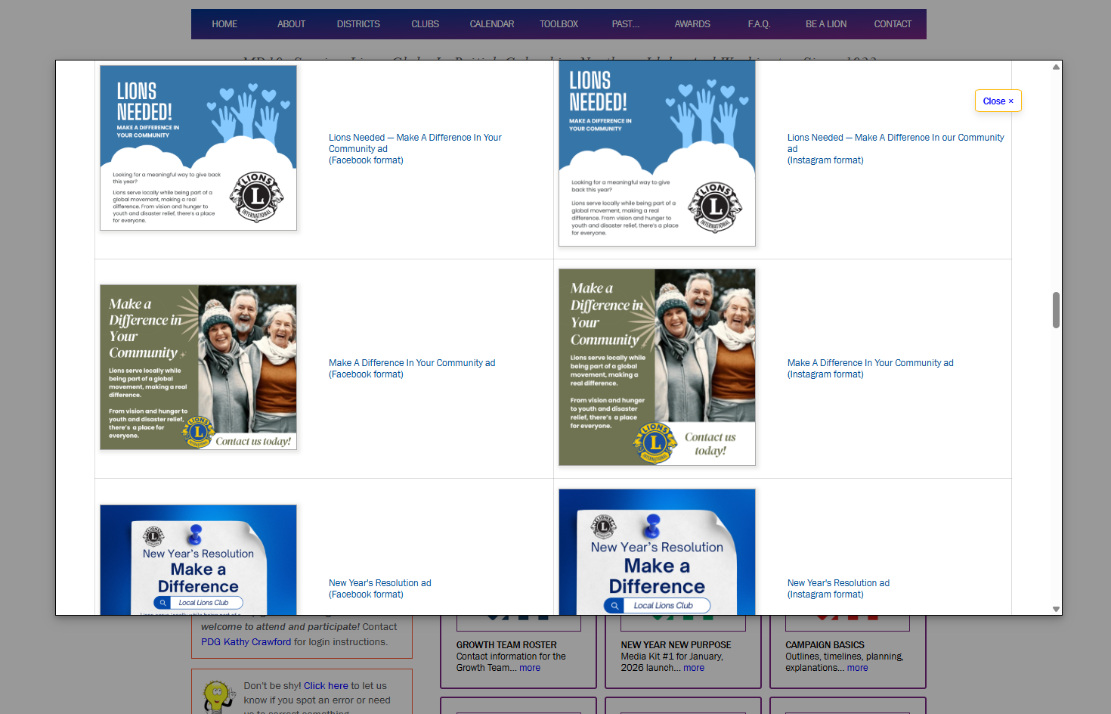
Notes:
Once that pop-up opens, you’re going to see a whole lot of graphics — and that’s a good thing.
Take a minute and actually look through them. What catches your eye? What feels like your club? And most importantly — what matches the audience you’re trying to reach?
You don’t need to use every graphic. Just choose a few that make sense for your club and that you can picture showing up on your Facebook page.
If you click on any image, it’ll open up in a larger view so you can really see it.
And from there, you’ve got two super simple options:
Option A: Right-click and Copy Image — then paste it directly into a Facebook post.
Option B: Right-click and Save Image — then upload it to Facebook like you normally would.
No special tools. No design skills. No Canva required. This is really just point, click, and post.

Slide 13
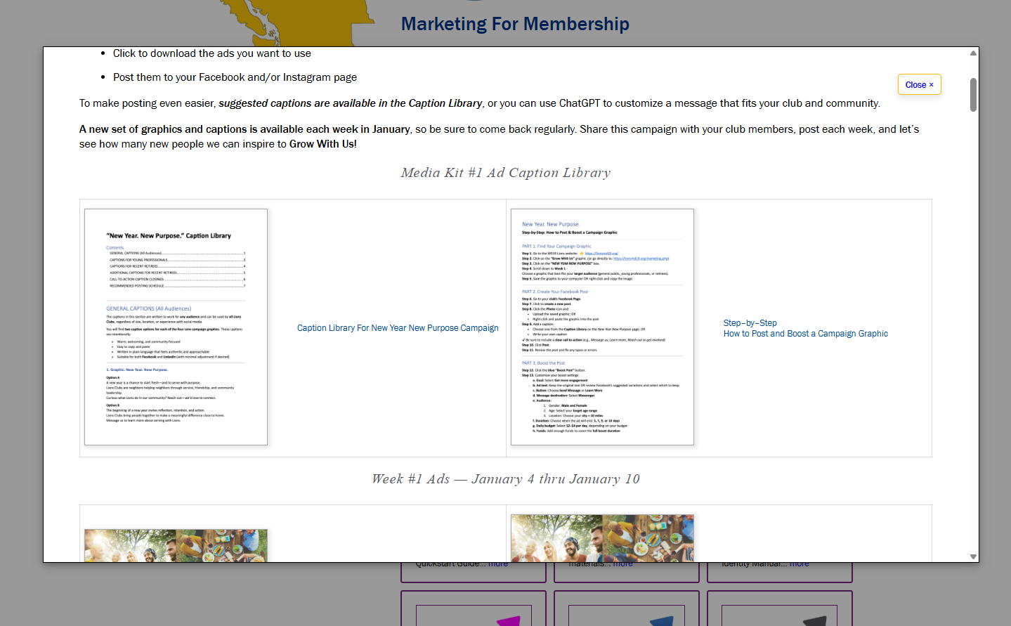
Notes:
Alright, once you’ve picked your graphic, the next step is making sure you add a caption to go with it.
It doesn’t have to be complicated. You can literally type the same words you see on the graphic — that’s totally fine. Or you can add a little extra context in your own voice.
And if you’re thinking, ‘I don’t know what to say,’ — no worries. We’ve got you covered.
Just go back to that pop-up screen and click on the Caption Library.
In the Caption Library, you’ll see a bunch of ready-to-use options. Take a minute to scroll through them, pick one you like, and copy and paste it as-is — or tweak it slightly so it sounds like your club.
The most important thing to remember is this: don’t forget the call to action.
We want people to know what to do next — whether that’s learning more, reaching out, coming to a meeting, or getting involved.
The Caption Library includes suggested calls to action, so you don’t have to guess. Just choose one, add it to the end of your post, and you’re good to go.

Slide 14
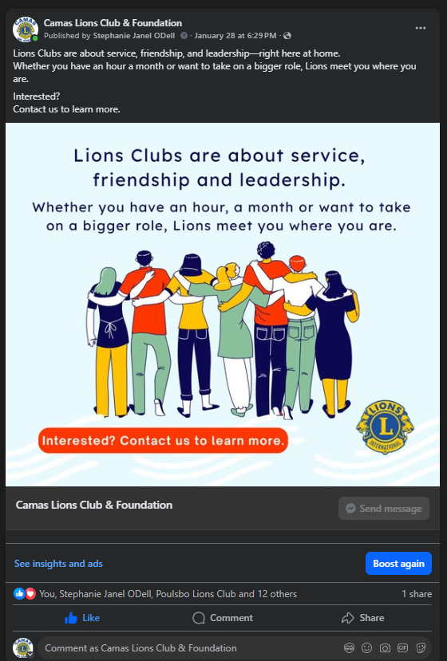
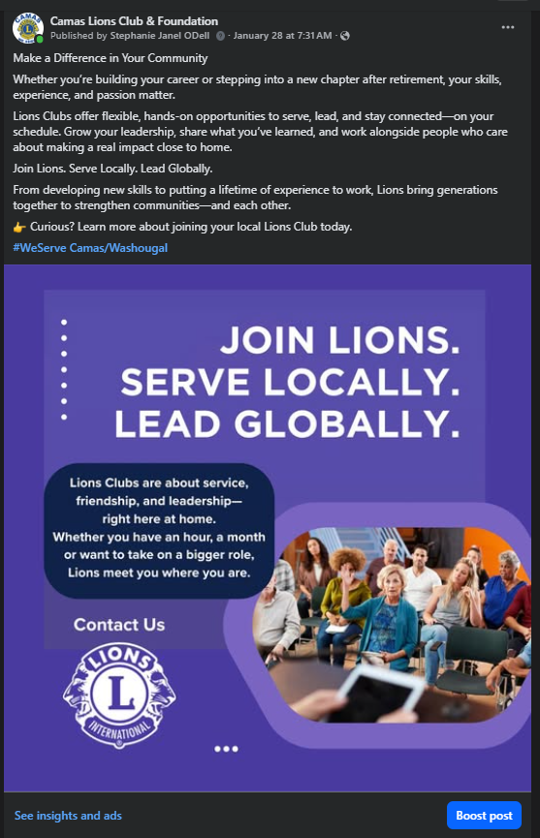
Notes:
I want to show you a couple of real examples so this feels doable — not theoretical.
These are two graphics and captions that were actually used by the Camas Lions Club.
Nothing fancy. No custom design work. We didn’t change the graphics — we just picked ones that fit our message.
We paired them with captions from the Caption Library, made a few small tweaks so they sounded like us, and added a clear call to action.
And that’s it.
These posts help do two things at the same time:
They show our service and impact
And they gently invite people to learn more or get involved
So when you’re wondering if this really works — this is what it looks like in the real world. Simple. Consistent. And easy to repeat.

Slide 15

What’s Next
Build the Foundation First
Consistent posting – service storytelling
Community-focused messaging
Visible service history
Then Test Paid Boosts
Start small
Learn what works locally
Adjust and improve
What’s Next?
Why This Matters
Boosts work best when supplementing with existing content
Visibility leads to awareness
Awareness leads to membership interest
15
Notes:
What’s Next
Everything we’ve talked about tonight is about building a strong foundation.
Before we spend any grant dollars on paid Facebook boosts, clubs need:
Consistent posting habits
Clear, community-facing messaging
A visible history of service and activity
Once clubs have built up quality content and a rhythm of posting, then we begin testing paid Facebook boosts.
Paid boosts work best when:
There is already other content on the page for people to scroll through
The message is clear and written for non-Lions
The post highlights real service happening in the community
Boosting without content is like inviting people to an empty room.
Our approach will be:
Start small and test
Learn what works in different communities
Adjust and improve over time
The goal of paid boosting is not just likes—it’s:
Increased visibility
Community awareness
Membership interest at the local level
This is about sustainability. We’re building marketing skills inside clubs that last beyond the grant.
Closing thought: When clubs consistently show their service, the community starts to notice—and growth follows.

