Slide 1

REDISTRICTING MULTIPLE DISTRICT 19
THE PATH TO SUCCESS

Slide 2
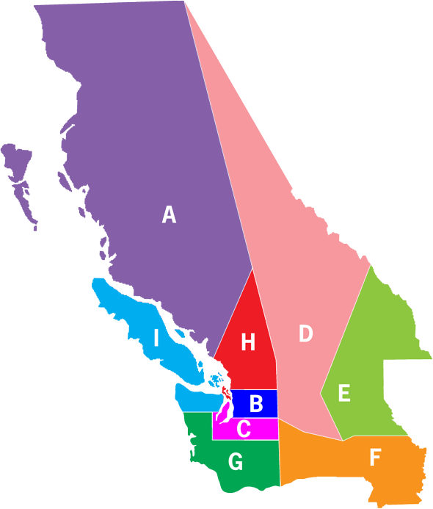
WHY? WHAT HAS HAPPENED?
CURRENT LAYOUT OF OUR MD 19
CURRENTLY 9 DISTRICTS
391 CLUBS
APPROXIMATELY 9,625 MEMBERS

Slide 3

LONG RUNNING ISSUES:
COVID 19 HIGHLIGHTED THE NEED AND URGENCY
OUT OF OUR 9 DISTRICTS 8 ARE IN TRANSITION
TRANSITION MEANS THEY DO NOT MEET THE MINIMUM OF 1,250 MEMBERS
OVER THE LAST 5 YEARS WE HAVE LOST AN AVERAGE OF 400 MEMBERS PER YEAR
LAST YEAR WE LOST OVER 800

Slide 4
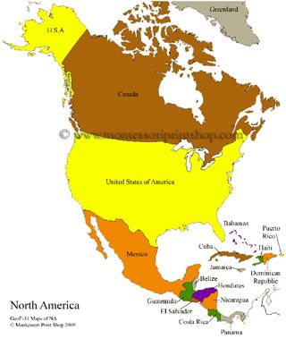
HISTORY OF OUR MULTIPLE DISTRICT
DISTRICT 19 WAS BORN IN 1922 AS A SINGLE DISTRICT IN BC, WASHINGTON AND OREGON
OREGON WAS SEPERATED OUT AS DISTRICT 36 IN 1925
NORTH IDAHO WAS ADDED IN 1936
ALASKA WAS ADDED IN 1943 AND REMOVED IN 1949 TO JOIN WITH NORTHWEST TERRITORIES
MD 19 FORMED IN (47-48) OF 5 SUB DISTRICTS A THROUGH E
D AND E WERE SPLIT TO FORM D, E AND F (50-51)
C WAS REORGANIZED INTO C AND G IN (63-64)
A WAS REORGANIZED INTO A AND H IN (66-67)
A AND H REORGANIZED AGAIN CREATING I (70-71)

Slide 5
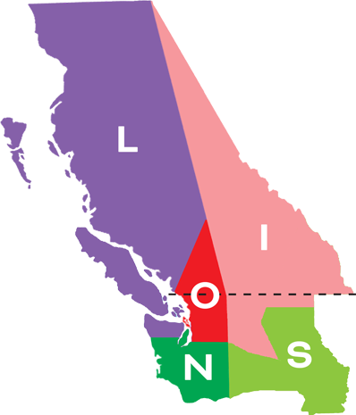
COMPARE THE PRESENT AND THE FUTURE
MD 19 2020 TODAY
MD 19 2023 OUR FUTURE

Slide 6
HOW DID WE GET HERE? COUNCIL OF GOVERNORS VOTED TO CREATE A PLAN FROM THE STRATEGIC PLANNING COMMITTEE TO GO FROM 9 TO 5 DISTRICTS
1. Districts A and I merge into new District (L) with 97 clubs, 14 zones and 2,071 members
2. Merge Districts B and H into new District (0) with 76 clubs, 13 zones and 1,951 members
3. Merge Districts C and G into new District (N) with 82 clubs, 11 zones and 2,345 members
4. Move Zones E-1, E-2, E-3, E-9 and E-11 from District E into District F, creating new District S with 69 clubs, 13 zones and 1,751 members
5. Move Zones E-4, E-5, E-6, E-8, and E-10 from District E into District D, creating new District (I) with 67 clubs, 13 zones and 1,499 members

Slide 7


How does this impact me
OR my club?
NOTHING!!!

Slide 8
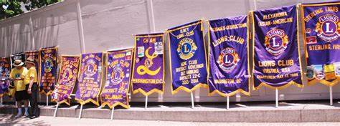
THERE ARE COSTS TO THE NEW DISTRICT:
NEW ZONE BANNERS
NEW DISTRICT GOVERNOR BANNER
HOME CLUB BANNER
TRAVEL
MEETING EXPENSES

Slide 9
LIONS CLUBS INTERNATIONAL
REDISTRICTING GRANTS
APPLICATIONS MAY BE SUBMITTED FOR ONE OR MULTIPLE YEARS
GRANTS LIMITED TO $2.00 PER DISTRICT MEMBER FOR THE FIRST YEAR
GRANTS LIMITED TO $1.00 PER DISTRICT MEMBER FOR THE SECOND YEAR
GRANTS ALSO ADD $10.00 PER NEW MEMBER ADDED EACH YEAR

Slide 10
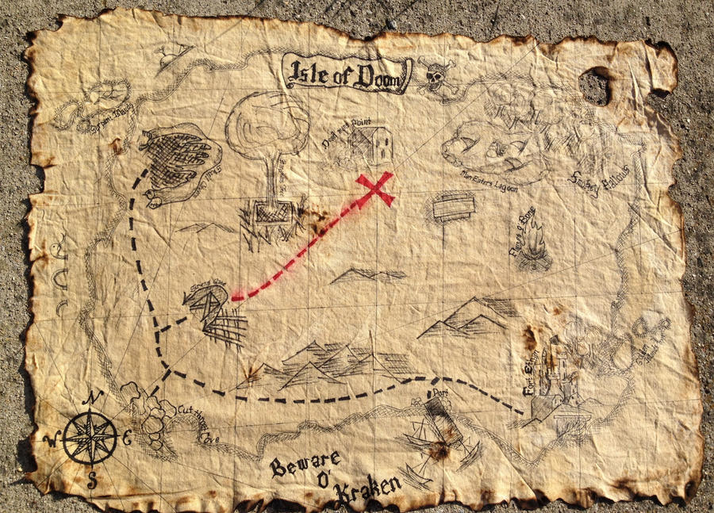
map of the directionS to accomplish redistricting
MANY STEPS HAVE TO BE FOLLOWED TO REACH OUR REDISTRICTING TREASURE

Slide 11


WHY?
NEW INSPIRED LEADERS MORE MEMBERS/MORE CLUBS

Slide 12


NEW
IDEAS PROJECTS

Slide 13
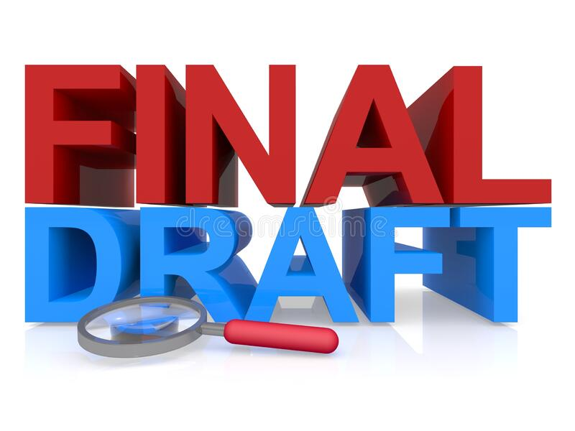
PLAN NEEDS TO BE FINALIZED
CURRENT PLAN NEEDS TO BE DISCUSSED BY THOSE IMPACTED
CLUBS, OR ZONES MAY WISH TO CHANGE THEIR FINAL DESTINATION
AT THE NEXT COUNCIL OF GOVERNORS MEETING, MD 19 CONVENTION ON NOVEMBER 5, 2021
APPROVED

Slide 14

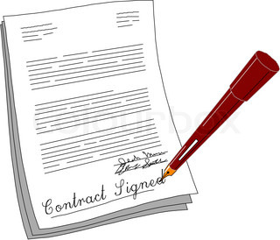
DETAILS FOR DISTRICTS TO EXAMINE:
CONSTITUTIONS & BY-LAWS CONSOLiDATE DISTRICT FUNDS

Slide 15

Order of succession?
Who serves as the new district governor?
1st & 2nd Vice District Governors from the two districts
who follows?

Slide 16

JANUARY 1, 2022
DRAFT PLANS COMPLETED &
SENT OUT TO EVERY CLUB IN THE MULTIPLE DISTRICT NO LATER THAN FEBRUARY 1ST
DISTRICT CONSOLODATION TEAM EXPLAIN PROCESS

Slide 17

MARCH 2022-MAY 2022
DISTRICTS PRESENT REDISTRICTING PLAN AT THEIR SPRING CONVENTION
A NONBINDING ADVISORY VOTE ON PLAN MAY BE TAKEN AND PRESENTED TO THE MD

Slide 18

END OF MAY OR JUNE 2022
DELEGATES TO THE MULTIPLE DISTRICT CONVENTION
BINDING VOTE TAKEN ON REDISTRICTION PLAN

Slide 19


APPLICATION FOR REDISTRICTING MUST GO TO LCI BOARD BY AUGUST 1, 2022 VOTE FOR APPROVAL BY BOARD OCTOBER 1, 2022

Slide 20

IMPLEMENTATION OF REDISTRICTING
JULY 1, 2023

Slide 21
DATES OF IMPORTANCE
NOVEMBER 2021 - MD 19 SEATED COUNCIL OF GOVERNORS VOTE TO FINALIZE PLAN TO REDISTRICT
JANUARY-FEBRUARY 2022 - FINALIZED PLANS GO TO EVERY CLUB IN MD 19
MARCH-MAY 2022 - INDIVIDUAL SPRING CONVENTIONS EXAMINE, DISCUSS AND MAY TAKE AN ADVISORY VOTE ON THE PROPOSED PLAN
LATE MAY/EARLY JUNE 2022 - BINDING VOTE IS TAKEN BY DELEGATES AT THE MD 19 SPECIAL CONVENTION
IN AUGUST 2022 - RESULTS OF VOTE ARE SENT TO LCI BOARD (60 DAYS AHEAD OF THEIR MEETING)
OCTOBER 2022 - LCI BOARD VOTES TO IMPLIMENT REDISTRICTING AT MEETING
JULY 1, 2023 - REDISTRICTING IS IMPLIMENTED

Slide 22

QUESTIONS?
COMMENTS
CONCERNS

